Slide 1
Springboot in VS

Slide 2
https://spring.io/
https://spring.io/guides/gs/spring-boot/

Slide 3
Getting Started with Java in VS Code
https://code.visualstudio.com/docs/java/java-tutorial

Slide 4
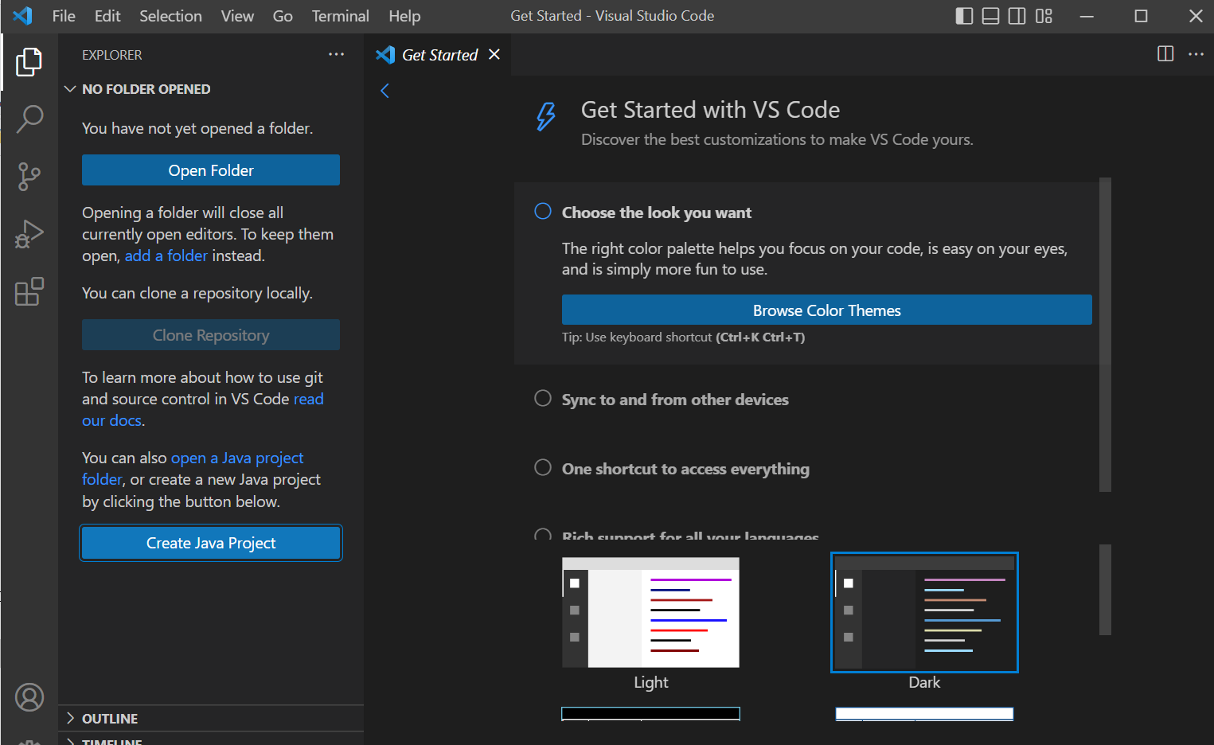

Slide 5
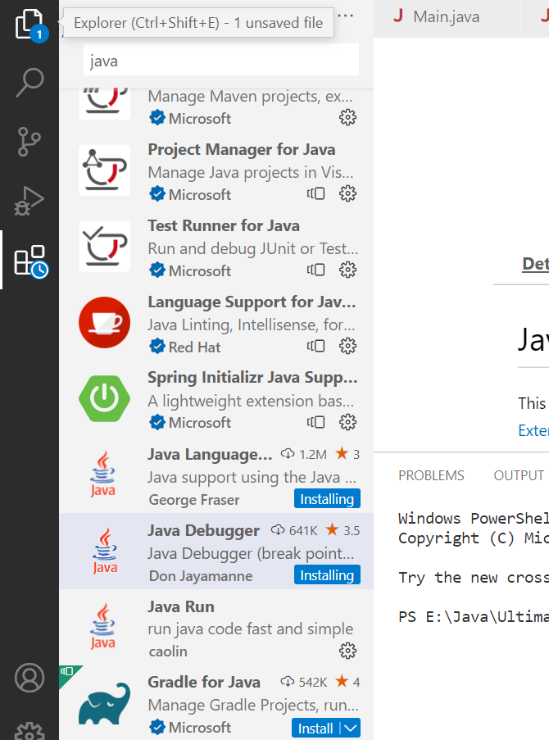
https://www.youtube.com/watch?v=KwnavHTOBiA

